Slide 1
r
Rod (as supporting beam)
Clamp and stand
Filars
Suspending rod
Mass is m, Inertia is I.
Camera and its direction of lens, aimed at the centre of mass of the rod (roughly the midpoint between the two filars), capturing the entire suspending rod.
l
G-clamp

Slide 2
1. Original position
5. Lifting jack is lowered, starting the rotation of the suspended rod
3. New position
Angle is kept constant.
6. Camera starts recording the movement for 30 oscillations, which is then used to find the average period

Slide 3
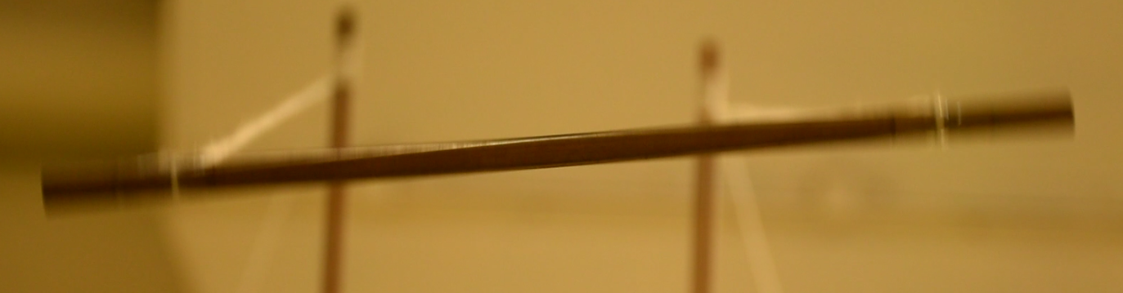
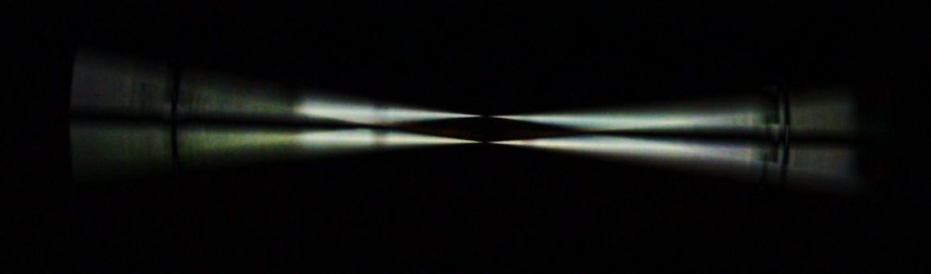
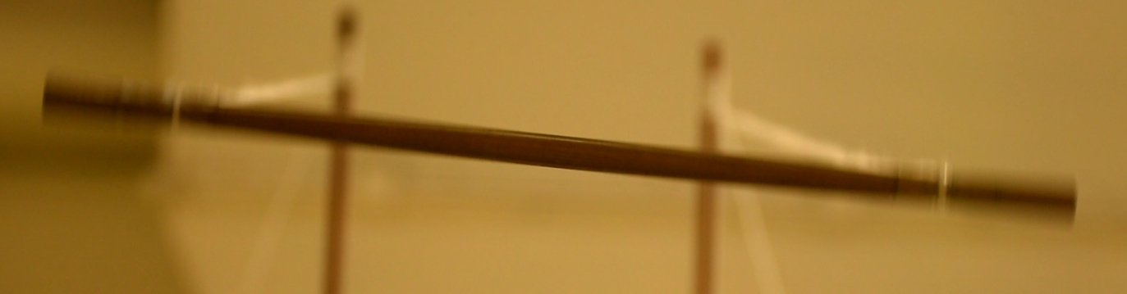
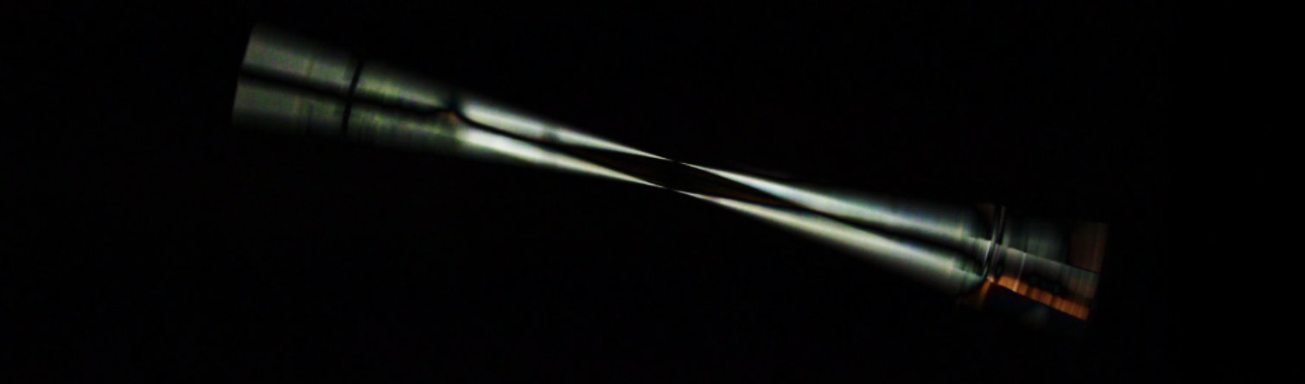
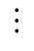
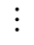
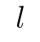
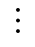
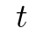
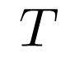
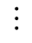
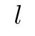
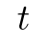
Compute the absolute difference of colour for each pixel between two consecutive images
Compute luminance of the greyscaled difference frame
Raw frames
Difference frames
Luminance
2.3298%
1.7543%
$$⋮$$
$$⋮$$
$$⋮$$
Plot luminance over time
$$l$$
$$l$$
mean+sd?
half-range?
Obtain the local minima of luminance per unit time, as it indicates that when the rotational motion of the rod approaches zero.
2.3298%
$$T$$
1.7543%
$$⋮$$
$$t$$
$$t$$
Multiplying time needed to finish half an oscillation by 2 gives the period.

